Slide 1

Competitive Programming From Problem 2 Solution in O(1)
P
T
H
I
N
K
F
A
S
T
S
Bugs
Mostafa Saad Ibrahim
PhD Student @ Simon Fraser University

Slide 2

Bugs
A software bug is an error, flaw, failure, or fault in a computer program or system that causes it to produce an incorrect or unexpected result, or to behave in unintended ways.
A Debugger, tool to help in catching bugs
Let’s see some bugs ☺
Notes:
http://university.utest.com/wp-content/uploads/sites/5/2014/07/311_0.jpg

Slide 3
Bugs
Run time Bugs
Not compilation ones.
Program can’t continue processing
E.g. Crash, Hang, network errors, hardware errors
Design Bugs
The designed approach to solve the problem is wrong
Implementation Bugs
Designed solution is correct, but implemetned wrongly
E.g. Bug in interst rate calculations (0.5% instead 5%)

Slide 4
Note: Undefined behaviours
Some type of errors are undefined behaviour in C++ Standard (why?!)
This means, when the problem occurs, no one knows what may happen ☹
Application may crash! May continue!
Sometimes, compilers may handle the error in a specific ways regardless of standard
Result => E.g. Sometimes buggy code works on g++ and fails on VS!

Slide 5
Invalid Array Indexing
Simply, we accessed position beyond range
May causes program Crash
No array bound checking in C++
Usually undetected
Java/C# detect that easily..they are between code and machine...C++ makes direct control
It will corrupt allocationed data structures
After you, the popular case
Before you, e.g. By usnig large unsigned index

Slide 6
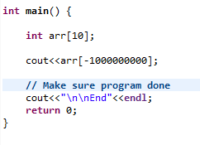
Invalid Array Indexing

Slide 7
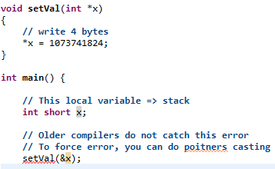
Illegal Stack Operations
Corruption surrounds local variables. Not frequent error

Slide 8
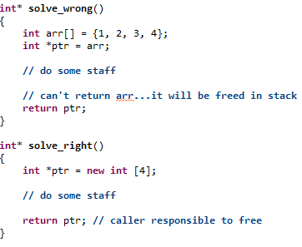
Illegal Stack Operations

Slide 9
Uninitialized Pointer Operations
Such pointer has garbage address
May causes program Crash
Corruption might be located in completely unrelated area of the code
Speical case: Accessing NULL Pointer
Java/C# doesn’t give pointers => No powerful memory access, but more safer
In structs, sometimes first member access works, and others causes crash!

Slide 10
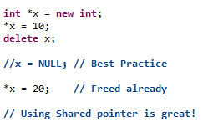
Unauthorized Buffer Operations
Created pointer. Used it. Freed it. Used it!
May causes program Crash
Can be confusing error in mult-threaded systems (to be studied in future)

Slide 11
Invalid operations
An invalid operation. E.g. arithmetic overflows and division by zero
Divison by zero of integer = undefiend
Divison by zero of float => may => inf or –inf
But again, the compiler plays critical role in what it does (e.g. Does’t it follow IEEE floating point standard)

Slide 12
Integer Divison by Zero
Usually, application crash. It is error NOT exception (To be studied in future)
Visual studio can handle as exception
Error Informal flow
Error happens on hardware level
Error returns to the Operating system
Operating system Interrupts the c++ main program with a signal to terminate it
Info: when program is running and you do CTrl+C => You are sending aborting signal

Slide 13
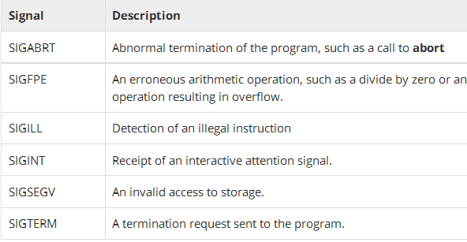
Signals Interruption
We can detect these Interruption signals through header #include <csignal>
However, not guaranteed

Slide 14
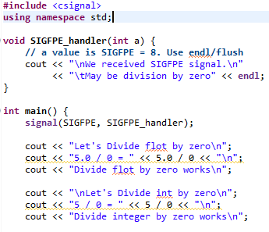
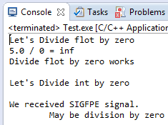
Signals Interruption

Slide 15
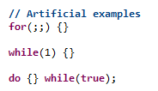
Infinite Loops
It may hang (memory leark, or finite processing)
Or others, e.g. crash for Index out of boundry error

Slide 16
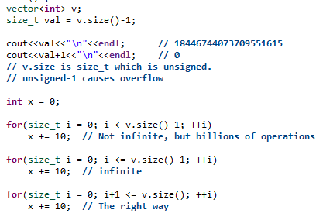
Infinite Loops: Real life case

Slide 17
Memory Leaks
Simply created a memory and did not free
Note: Watching memory of a function before calling and after may tell you if some leak is there
Using Shared Pointer Decreases such errors highly. But watchout from circular shared pointers..Object will never be freed.

Slide 18
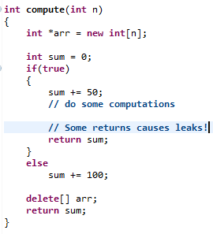
Memory Leaks

Slide 19
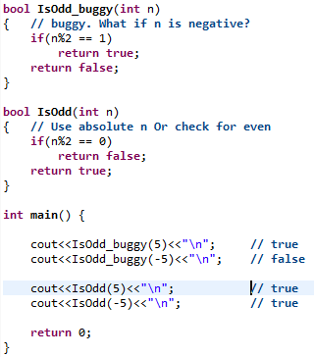
Implementation Bugs

Slide 20
Little on real life
Bug Severity
Critical, Major, Moderate, Minor, ... Etc
Bug causes
Firefox restarts every 3 hours => Critical
Must click twice on facebook icon to open facebook app? => Moderate
Screen display “thm” instead of “them” => Minor
Bug Priority
After 2050, Firefox restarts every 3 hours => Low
Bug tracking system

Slide 21
Always code as if the guy who ends up maintaining your code will be a violent psychopath who knows where you live.
Rick Osborne

Slide 22
Tips to minimize bugs
Follow specific coding styles. E.g. Google
Write clean code
Eclipse Formatter: Ctrl+Shift+F
You can download Google XML formatter
Validate as possible (e.g. Check for division by zero before dividing)
Divide code to methods\functions (~40 lines)
For every function, create corresponding test function. Evaluate all possible cases.

Slide 23
Tips to minimize bugs
For smarter implementations, run it against random / stress test vs the slowest implementations
AVOID copy-paste...it causes problems
When using a library function, READ its documentation. Experiment it seperately
Future ToDos
Read about coding best practices
Read in scott meyers effective c++ series

Slide 24
Handling dicovered bugs
When you realize a bug during run time..y0u handle it (e.g. You are about to divide / 0)
There are variety of ways that people may use. There are debates around them
Styles
Error Codes
Using Exceptions
....

Slide 25
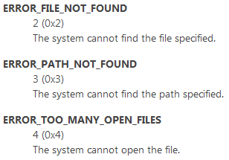
Error Codes approach
Define list of error codes and messages
When facing a problem, return error code for that. Microsoft is using that.
See Microsoft Error codes list.

Slide 26
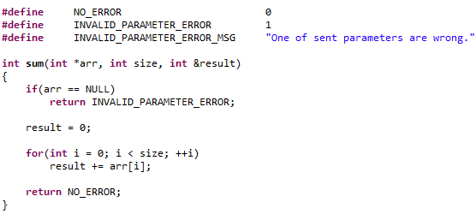
Error Codes approach

Slide 27
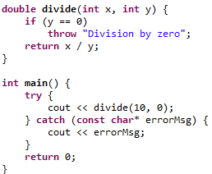
Exceptions
To be studied later

Slide 28
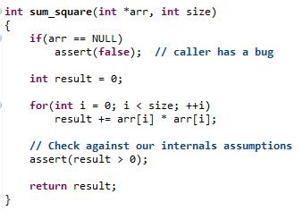
Using assertions
Sometimes, developers use assertion. There are debates on usage reasons.

Slide 29
Testing
Testing skill is important
Boundry cases: Test the very smallest input and largest ones
Manually designed cases: Design and TRACE
Make sure every part of code is traced
Think about input varities
f(x) => Try negative, positive, even, odd, prime, 0, 1
General/random test cases
Learn from your mistakes ☺

Slide 30
Debugging using print statement
Debugging is the activity of finding bugs, solving them. This may involve Code Tracing
A popular, but not effective approach, is printing messages (echo printing) to find the bugs
A more effective approach, is to use a debugger, a program that let you inspect run time behaviour

Slide 31
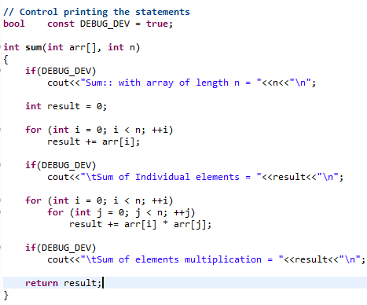
Debugging using print statement

Slide 32
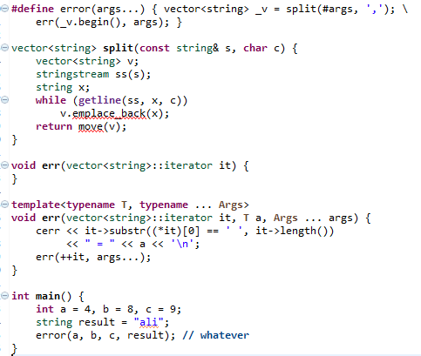
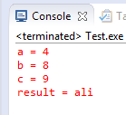
C++ 11 in print statement style
Notes:
Src: Codeforces article...todo add

Slide 33
Professional Development
In professional development, we use a logger mechnism...instead of echo printing
It is a library that prints on different levels (info, warning, errors)
It can print time before statement
You control which level to log (e.g. Only errors) .. Or All if if we have hidden bug
We save logging on file to examine when wrong behaviour happens

Slide 34
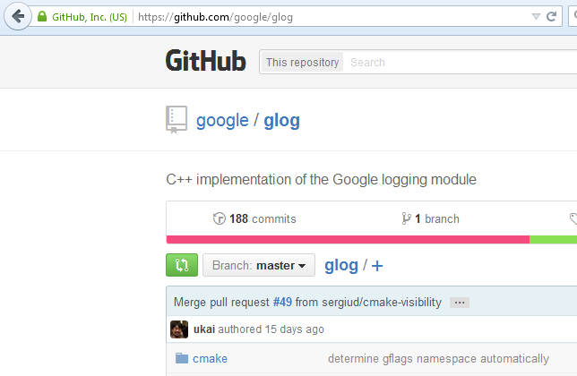
Professional Development: glog

Slide 35
Finally
You will make bugs...now and later ☺
The clever developer minimizes them highly
Learn from your mistakes...repeating a mistake is a bad sign!
Record all your mistakes in a file..revise them from time to time

Slide 36
تم بحمد الله
علمكم الله ما ينفعكم
ونفعكم بما تعلمتم
وزادكم علماً

